Slide 1
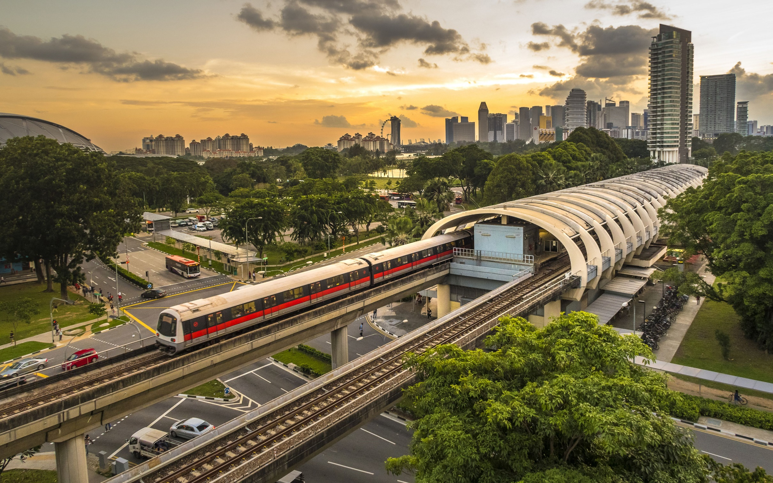
WeTransport

Slide 2

What’s our project
To create an application that will help to enhance commuter’s transportation experience!

Slide 3
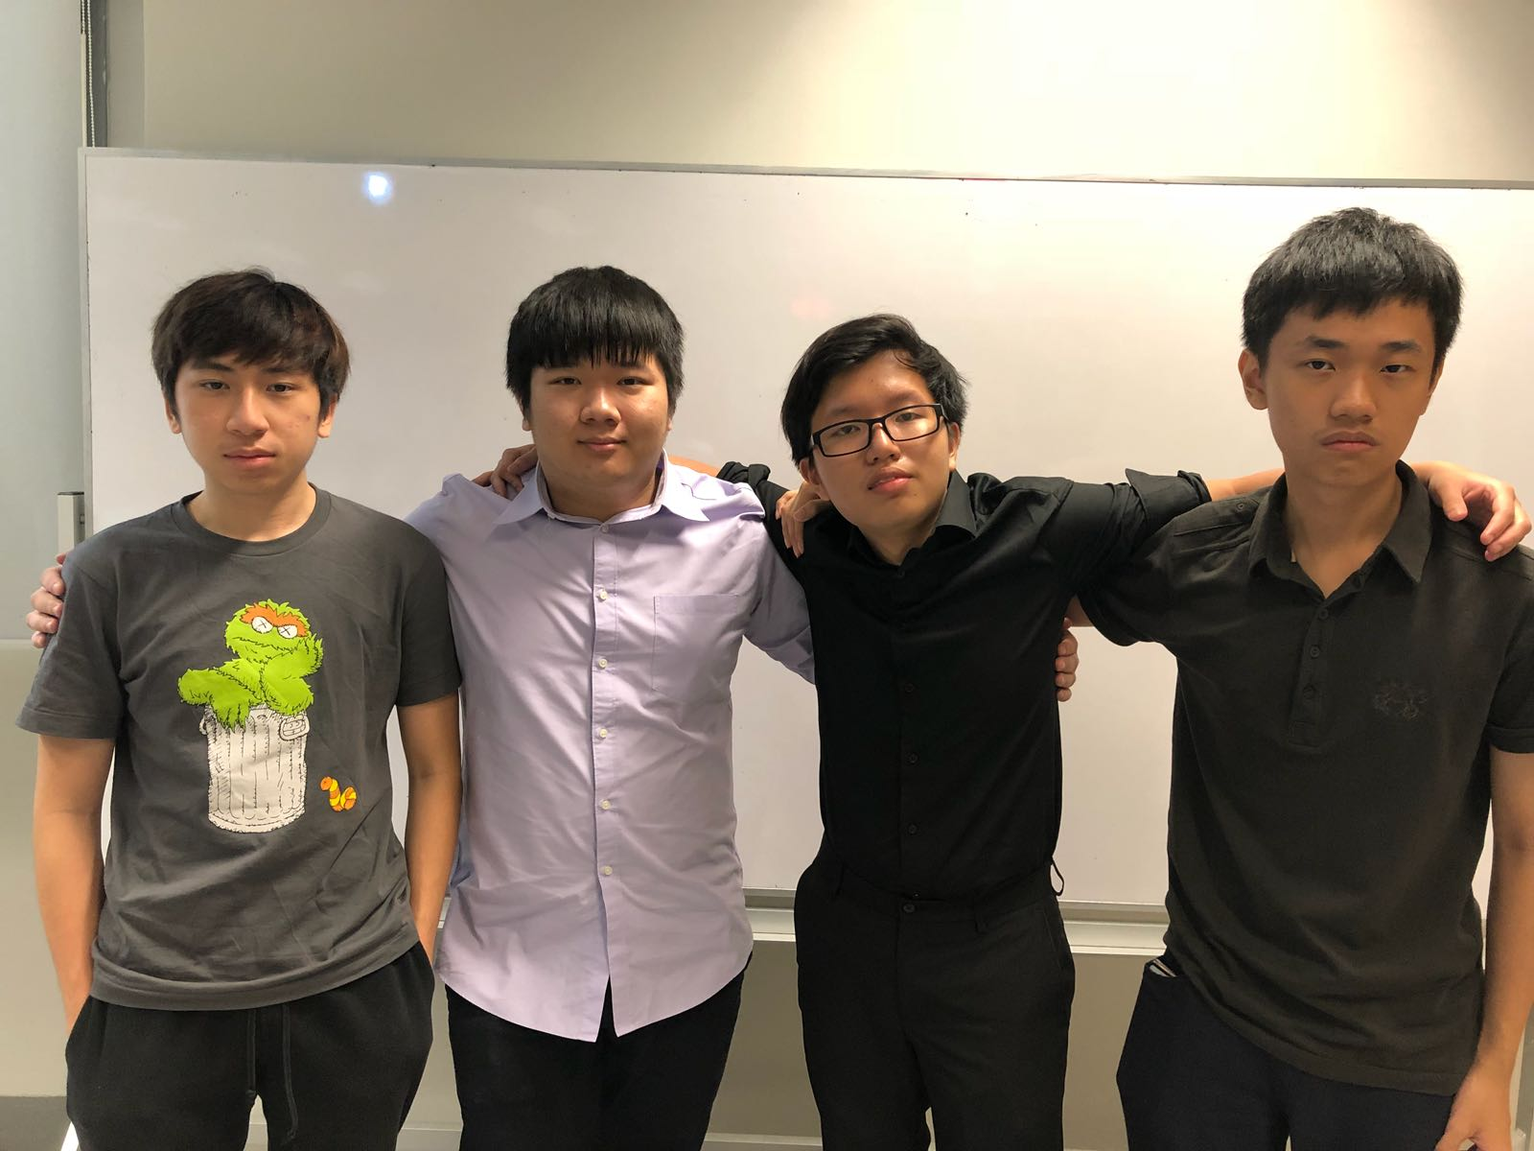
Members
Bryan Ang
Marcus Chain
Goh Tiong Hui
Tay Jing Yi (Leader)

Slide 4
Task Allocation
Jing Yi ( Product Page, FAQ Page, Design Thinking Page, Marvel Prototype, Social media and email for company, Web design , Script for company video and presentation and also this PowerPoint)
Tiong Hui ( App Update Page, Contact Us Page, Integration of website, did responsive website, web issues and web design)
Bryan ( Home Page, Beta sign up page, assist in Design Thinking Page ,marvel prototype and integration of website , resolve web issues, Make Contact Us Box work, web design)
Marcus ( About Us Page, App Review Page, assist in marvel prototype, Edit Company video, Create App Video and company logo, web design)

Slide 5


